Slide 1
BOLERUS SATANAS
Dr Gokul Krishna K

Slide 2
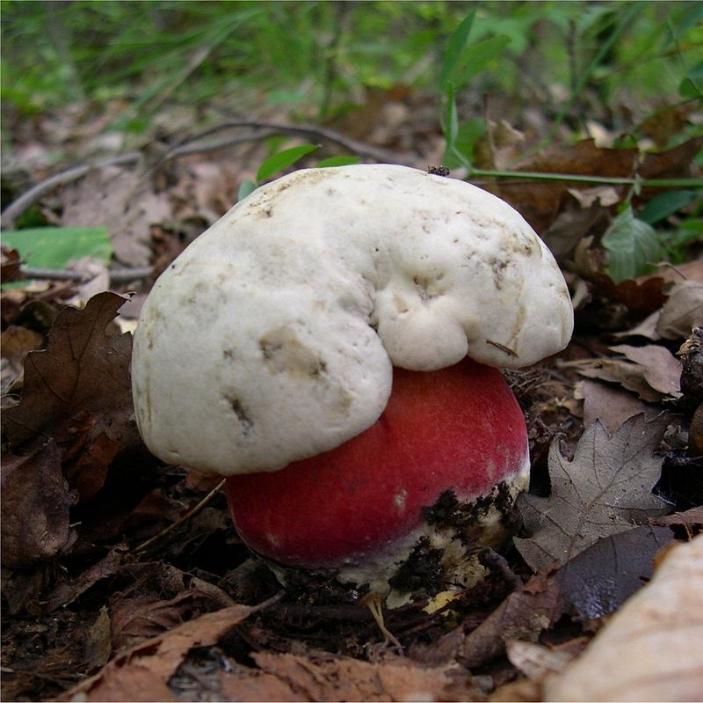

Slide 3
Rubroboletus satanas, commonly known as the Satan's bolete or Devil's boletus.
It is a basidiomycete fungus of the bolete family.
It was known scientifically as Boletus satanas until 2014.

Slide 4
Found on chalky soil in mixed woodlands in the southern, warmer regions of Europe.
It is generally regarded as a poisonous mushroom, with predominantly gastrointestinal symptoms of nausea and violent vomiting occurring if eaten raw or fried.

Slide 5
CLINICAL USES:
- Diarrhoea membranosa; Dysentery.
CHARACTERISTICS:
- There are two fragmentary provings of this fungus, and observations on six persons poisoned. It produces gastro-enteric disturbances.

Slide 6
MIND:
- Fear and restlessness.

Slide 7
EYES:
- Sparks before eyes alternating with obscuration of vision.

Slide 8
MOUTH AND THROAT :
- Troublesome dryness in mouth and throat
- Violent burning and scraping in throat.

Slide 9
STOMACH :
- Unquenchable thirst
- Sudden desire to vomit; no nausea between attacks
- Vomited twenty times in three hours.
- Frightful pain in stomach.

Slide 10
STOOL:
- A profuse diarrhoea of blood, and of the mucous lining of the intestines
- Watery evacuations.

Slide 11
GENERALITIES:
- Sudden sensation through all his limbs as if he would be attacked with apoplexy.
- Violent and extremely painful cramps in the muscles of the limbs and face.
- Faintness while vomiting.
- Limbs cold; cold sweat over whole body.

Slide 12
THANK YOU……..

